Slide 1
Data Science Fundamentals
knn

Slide 2
Before we get started…
Practicalities

Slide 3
Learning objectives
You understand and apply different types of regression, know when and how to use them, can execute them and put them in to practice as well as interpret the results.
You recognize overfitting in regression models and learn techniques to prevent overfitting.
You learn about different clustering techniques and understand when and how to use them for grouping data.
You gain an understanding of dimensionality reduction techniques and learn how to apply
them to compress and visualize data.

Slide 4

Course material
Canvas
  Slides & exercises from classes
Online
  https://www.w3schools.com/datascience/
Software
  JupyterLab (or work via Anaconda/VS Code if you prefer)
The Internet

Slide 5
Course breakdown
Course Structure:
  Lectures: 3 hours per week (theory and exercises)
  Attendance: Mostly not compulsory, but strongly recommended.
Examination Breakdown:
  30%: Continuous assessment (mandatory excercises)
  70%: Final exam (oral, mostly theoretical with some practical elements)

Slide 6

Is it difficult to pass?
It’s perfectly doable if you put in the work
Come to class
Participate in the lessons
Make your exercises

Slide 7
How to be an ideal student
Attend classes - even when you party hardy
Show respect - towards your instructor and fellow students
Be punctual - or you'll find the door closed
Meet deadlines - late submissions will earn a solid zero
Have a question? - just ask! I don't bite
Know it all? - help your classmates, they might repay you with pizza
Do your own work! - shortcuts will lead to a short academic career ;)

Slide 8
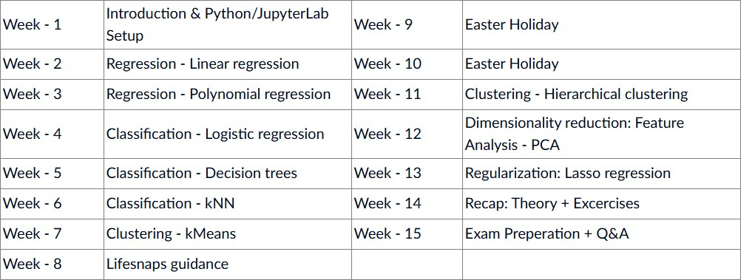
Syllabus
(subject to change)

Slide 9
Now we get to the fun part
knn (k Nearest Neighbours)

Slide 10

What is knn
‘k nearest neighbours’
Finds similar datapoints
Each datapoint ‘votes’ on a class
Majority vote: class with most votes wins!
‘k’ represents the amount of closeby datapoints to consider
Notes:
We will just take a look to the neighbours.
K = The amount of neighbours.
Does this data point have majority vote?

Slide 11
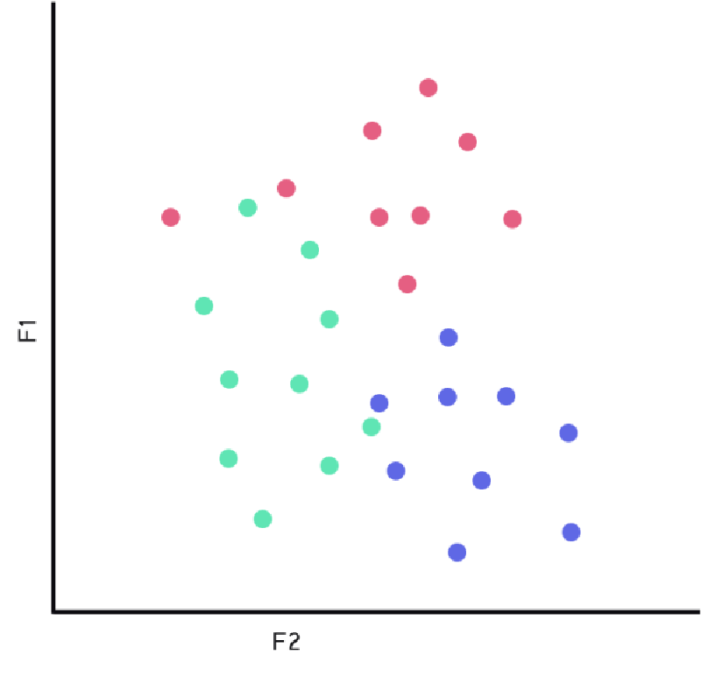


Slide 12

Metrics
Once more, the same metrics apply:
Accuracy
Precision
Recall
Specificity
F1 score

Slide 13
Overfitting
‘knn’ tends to overfit on low values of k.
  → doesn’t learn patterns, just remembers some data
On high values it tends to underfit
  → doesn’t learn patterns, just does the same for every datapoint
The best value is somewhere in between!
How do we combat this?
  Just like with random forests, we want to introduce randomness and
quantity to get the best unbiased result
Notes:
In this case it’s reversed: lower values of k means OVERFITTING!
Why is that? Well a low k means you don’t care about a lot of your surrounding neighbours. That means you likely also don’t care about any pattern or other surrounding values.
That could make it so that 2 datapoints can be extremely close for you to become that class, while there are 10 just barely outside of that range. Of course it was better to become one of those 10 because they have more votes! But you don’t look much at all at any other neighbours.
But then a k that is too high means to underfit. Then you look at too many datapoints.

Slide 14
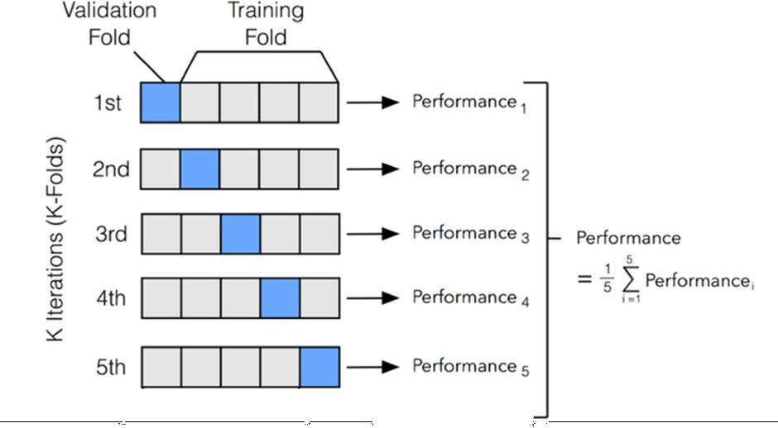
Cross validation
Used to compare different models
Create ‘folds’ in the data
For each fold, train a model with that fold as test set
Take the average outcome: classification → majority vote!
Special cases:
  ‘Holdout’
  ‘leave-one-out’
  ‘Stratified’

Slide 15
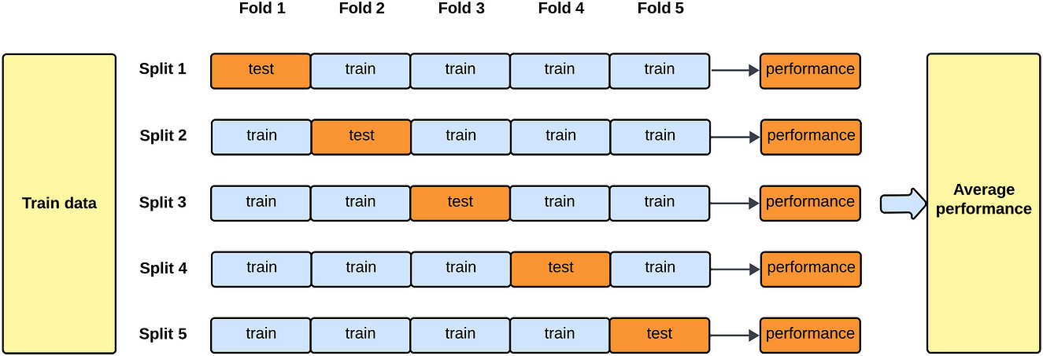
K-fold
‘k’ represents the amount of folds
Most common model: 10-fold
The value of ‘k’ cannot be higher than the amount of datapoints!
Source:Haden Pelletier, How-To: Cross Validation with Time Series Data (Medium 2023)

Slide 16
Let’s jump into action
Excercises

Slide 17

First, let’s explore this together
Go to canvas and download the notebook “DSF 06 – knn Notebook”
Open the notebook in Jupyter
  Open a CMD and run “jupyter lab”
  Or launch it via anaconda
Follow along!

Slide 18

Now it’s up to you!
Go to canvas and download the notebook “DSF 06 – knn Exercise”
Also download the csv file called “Sonar.csv”
Place them in the same directory
Open the notebook in Jupyter
  Open a CMD and run “jupyter lab”
  Or launch it via anaconda
Go through the notebook and make the excercises
I don’t bite, ask me any questions you have!
And yes, this one is graded ;)

